Slide 1
Document Data Modeling with MongoDB – Common Slides (sourced from various places)

Slide 2
Sections
Part 1: Comparing Relational & Document Models
Part 2: A Document Modeling Methodology
Part 3: Document Modeling Design Patterns
Part 4: Time-Series Data Modelling

Slide 3
Part 1: Comparing Relational & Document Models

Slide 4
Lets look at a Contacts Address Book

Slide 5
Twitters
name
location
web
bio
Groups
name
Addresses
type
street
city
state
zip_code
N
1
N
N
1
Contacts
name
company
title
1
Thumbnails
mime_type
data
Phones
type
number
1
1
1
N
Portraits
mime_type
data
Emails
type
address
1
1
1
N
Address Book Entity-Relationship
(for this example lets assume a contact has one and only one twitter handle)

Slide 6
Twitters
name
location
web
bio
Groups
name
Addresses
type
street
city
state
zip_code
N
1
N
N
1
Contacts
name
company
title
1
Thumbnails
mime_type
data
Phones
type
number
1
1
1
N
Portraits
mime_type
data
Emails
type
address
1
1
1
N
One to One

Slide 7
One to One Schema Design Choices
contact
twitter_id
twitter
1
1
Contact
twitter
May save a fetch?
1
twitter
contact
twitter
contact_id
1
1
May be redundant to track relationships on both sides
Both references would need to be updated for consistency

Slide 8
One to One General Recommendations
Full contact detail all at once
Contact embeds twitter
Parent-child relationship
“contains”
No additional data duplication
Can query & index on embedded field
e.g. ‘twitter.name’
Exceptional Cases…
Reference Portrait which has very large data
Contact
twitter
1
twitter

Slide 9
Twitters
name
location
web
bio
Groups
name
Addresses
type
street
city
state
zip_code
N
1
N
N
1
Contacts
name
company
title
1
Thumbnails
mime_type
data
Phones
type
number
1
1
1
N
Portraits
mime_type
data
Emails
type
address
1
1
1
N
One to Many

Slide 10
One to Many Schema Design Choices
Contact
phone_ids: [ ]
phone
1
N
Contact
phones
Above is not possible in relational DBs
N
phone
contact
phone
contact_id
1
N
May be redundant to track relationships on both sides
As both references would need to be updated simultaneously for consistency

Slide 11
One to Many General Recommendations
Full contact detail all at once
Contact embeds multiple phones
Parent-child relationship
“contains”
No additional data duplication
Can query & index on any field
e.g. { “phones.type” : ”mobile” }
Exceptional Cases…
Two very loosely related entities
Contact
phones
N
phone

Slide 12
Twitters
name
location
web
bio
Groups
name
Addresses
type
street
city
state
zip_code
N
1
N
N
1
Contacts
name
company
title
1
Thumbnails
mime_type
data
Phones
type
number
1
1
1
N
Portraits
mime_type
data
Emails
type
address
1
1
1
N
Many to Many

Slide 13
Many to Many Traditional Relational Association
X
Join table
Groups
name
GroupContacts
group_id
contact_id
Contacts
name
company
title
phone
Use arrays instead

Slide 14
Many to Many Schema Design Choices
Group
contact_ids: [ ]
contact
group
contacts
Contact
groups
N
N
N
N
contact
group
group
Contact
group_ids: [ ]
N
N
Duplicate data on each side
But both must be updated simultaneously for consistency
May be redundant to track relationships on both sides
As both references would need to be updated simultaneously for consistency
Holding an indexed reference array on just 1 side still answers both types of queries, leveraging the same index 1. What contacts does a specific group contain?
2. What groups is a contact a member of?

Slide 15
Many to Many General Recommendations
group
Contact
group_ids: [ ]
Depends on use case
Address Book
Contact references groups
M:M relationships often composed of 1:Many in one direction & 1:Few in the other (hint: hold array on 1:Few side – which in this case is on ‘contacts’ – a contact is a member of a few groups)
Corporate email groups
Group embeds contacts for performance
Exceptional cases
Pure raw throughput requirements (i.e. reduce disk seeks to bare minimum)
Avoiding Working Set exceeding RAM for performance
N
N

Slide 16
Twitters
name
location
web
bio
Groups
name
Addresses
type
street
city
state
zip_code
N
1
N
N
1
Contacts
name
company
title
1
Thumbnails
mime_type
data
Phones
type
number
1
1
1
N
Portraits
mime_type
data
Emails
type
address
1
1
1
N
Then: Relational based

Slide 17
Groups
name
Contacts
name
company
title
group_ids []
portrait_id
N
addresses
type
street
city
state
zip_code
N
N
1
twitter
name
location
web
bio
N
1
phones
type
number
1
1
N
thumbnail
mime_type
data
emails
type
address
Portraits
mime_type
data
Now: Document based

Slide 18
Part 2: A Document Modeling Methodology

Slide 19
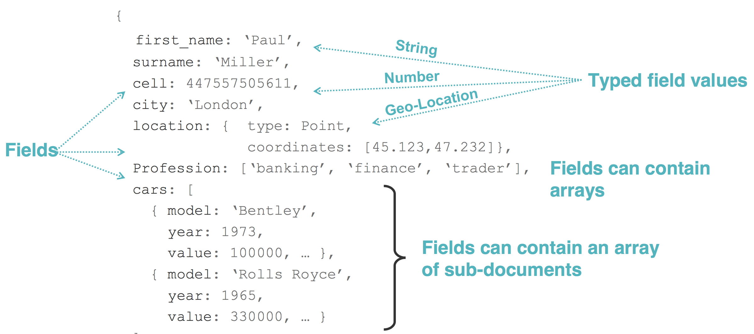
JSON Document Model Overview

Slide 20
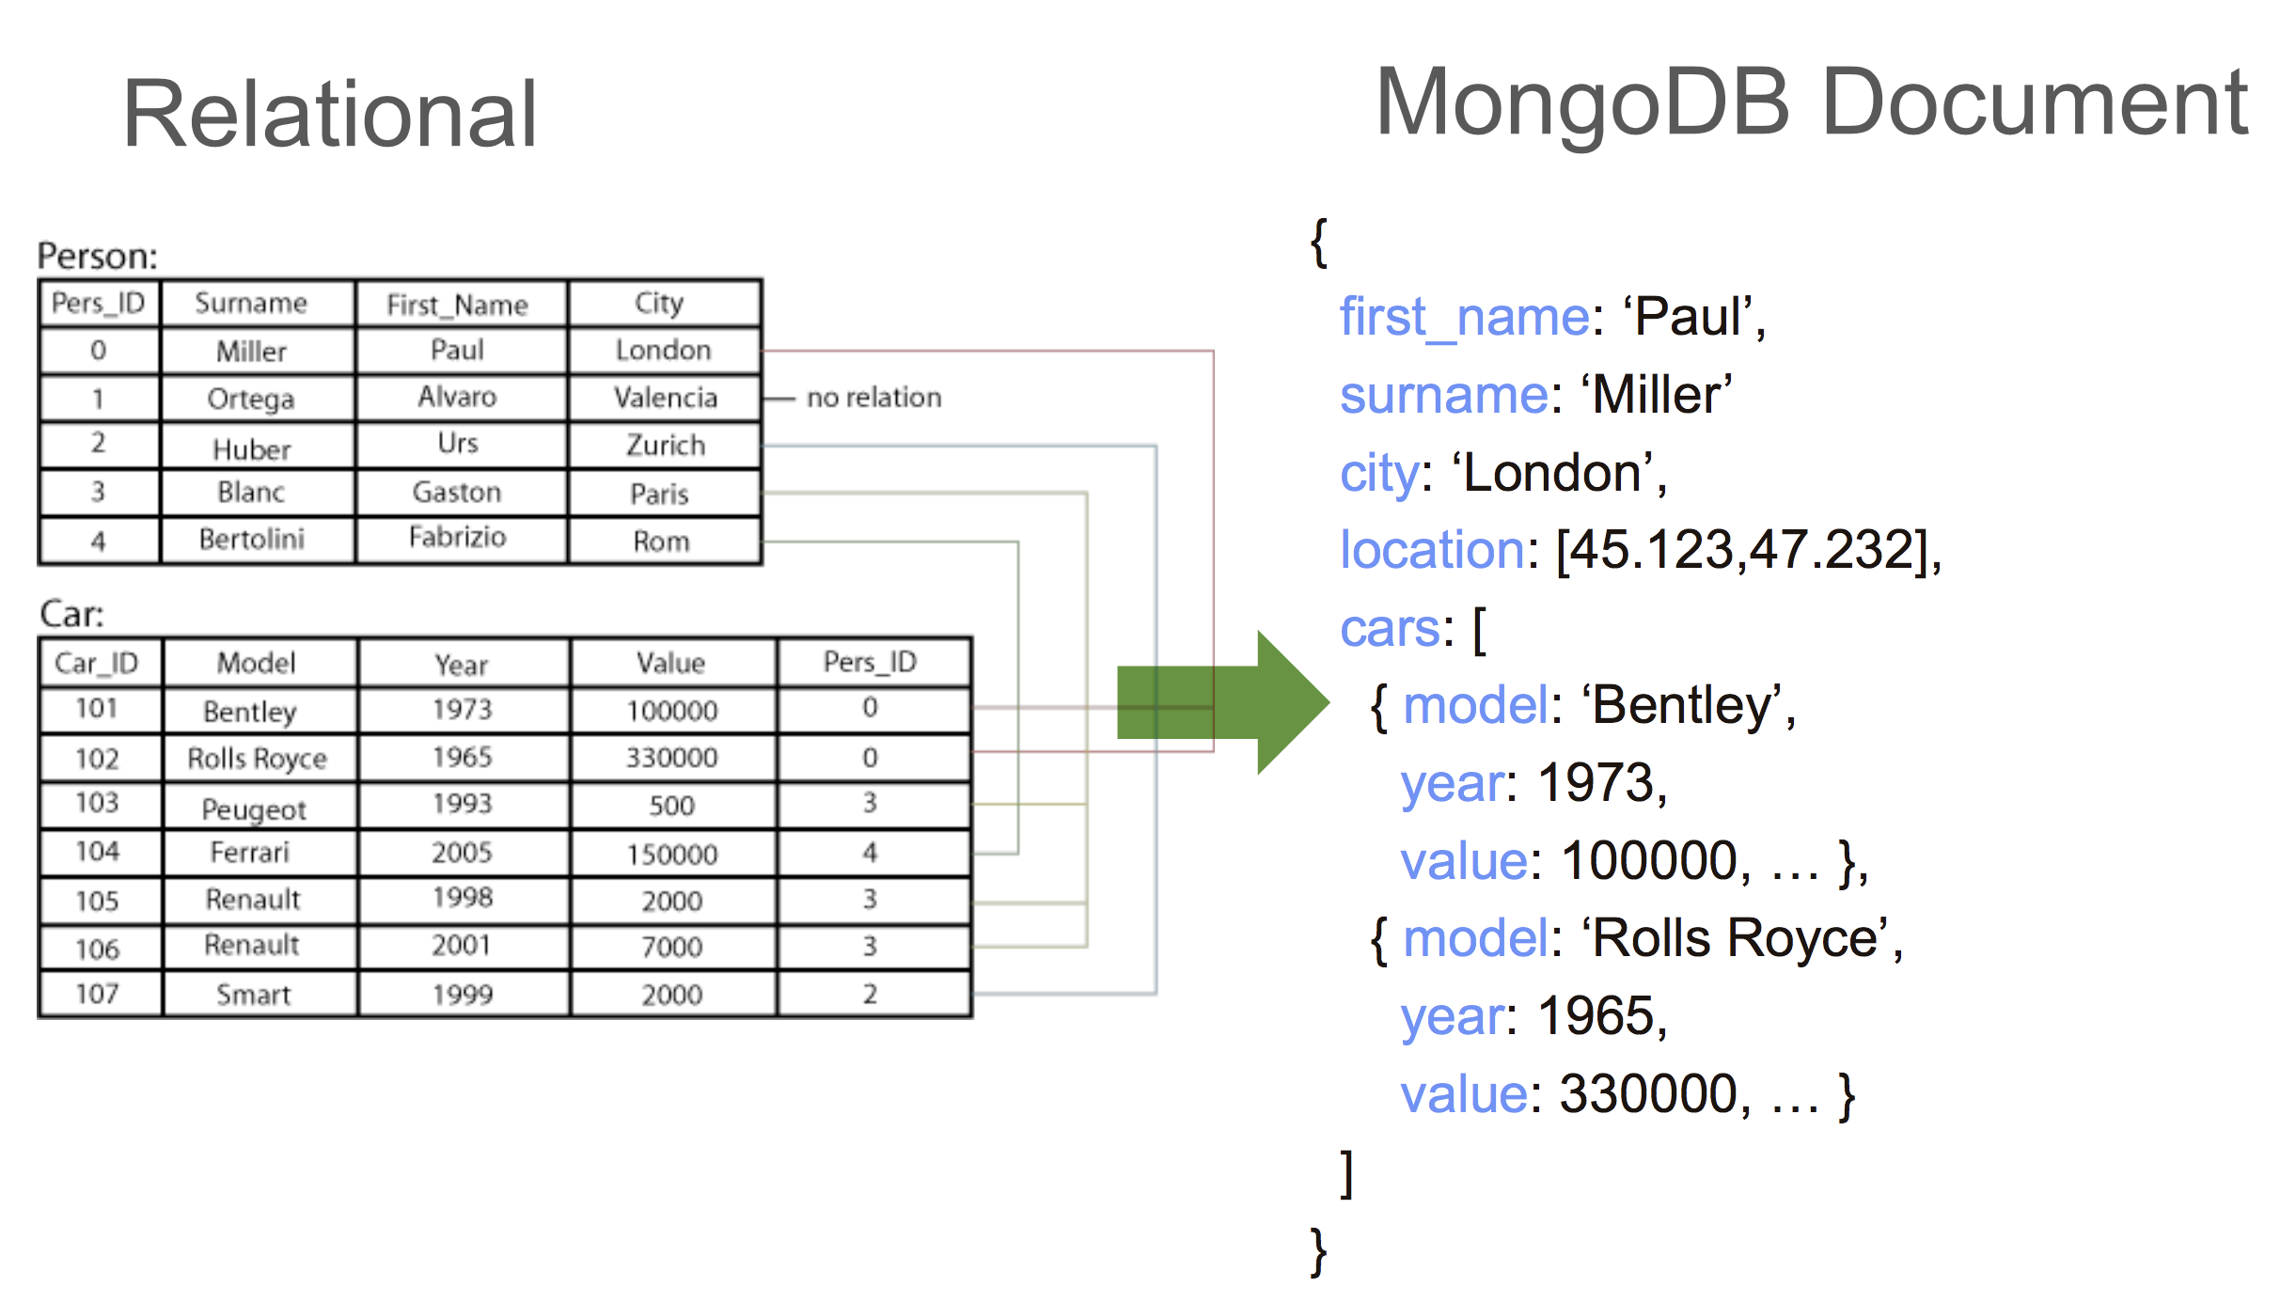
Thinking in Documents
Polymorphism
different documents may contain different fields
Array
represent a "one-to-many" relation
index entry separately
Sub Document
grouping some fields together
JSON/BSON
documents shown as JSON
BSON is the physical format

Slide 21
Document Model Best Practices
Represent all aspects of data
Good query performance
Flexibility to handle changing data and query requirements
Optimize hardware footprint
RAM
IO
Developer productivity/agility
Easy to understand
Easy to development
Scalability

Slide 22
Differences: Tabular vs Document
 | Tabular | MongoDB
Steps to create the model | 1 – define schema 2 – develop app and queries | 1 – identifying the queries 2 – define schema
Notes:
We also refer to a Relational Database as a Tabular Database

Slide 23
Differences: Tabular vs Document
 | Tabular | MongoDB
Steps to create the model | 1 – define schema 2 – develop app and queries | 1 – identifying the queries 2 – define schema
Initial schema | 3rd normal form one possible solution | many possible solutions

Slide 24
Differences: Tabular vs Document
 | Tabular | MongoDB
Steps to create the model | 1 – define schema 2 – develop app and queries | 1 – identifying the queries 2 – define schema
Initial schema | 3rd normal form one possible solution | many possible solutions
Final schema | likely denormalized | few changes

Slide 25
Differences: Tabular vs Document
 | Tabular | MongoDB
Steps to create the model | 1 – define schema 2 – develop app and queries | 1 – identifying the queries 2 – define schema
Initial schema | 3rd normal form one possible solution | many possible solutions
Final schema | likely denormalized | few changes
Schema evolution | difficult and not optimal likely downtime | easy no downtime

Slide 26
Differences: Tabular vs Document
 | Tabular | MongoDB
Steps to create the model | 1 – define schema 2 – develop app and queries | 1 – identifying the queries 2 – define schema
Initial schema | 3rd normal form one possible solution | many possible solutions
Final schema | likely denormalized | few changes
Schema evolution | difficult and not optimal likely downtime | easy no downtime
Performance | mediocre | optimized

Slide 27
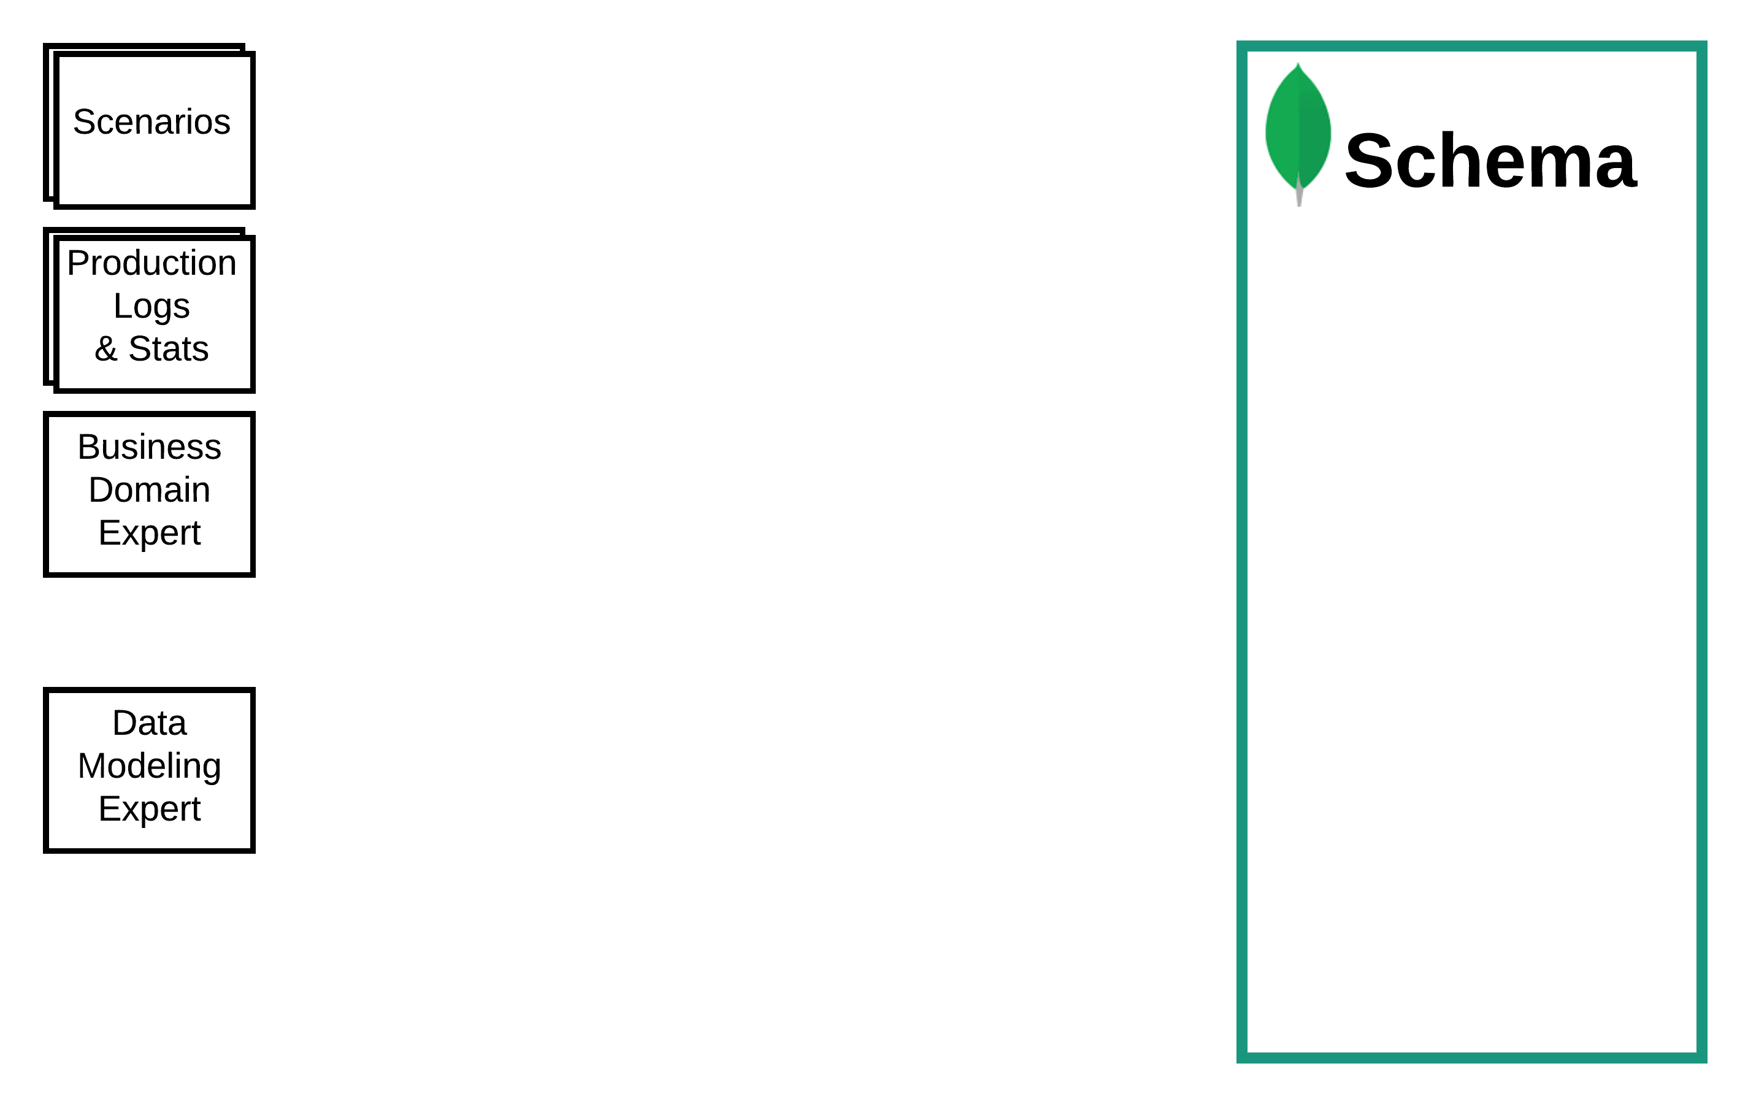
Data Modelling Methodology
Notes:
Different inputs available
Migrating from a RDBMS would provide logs and stats on the current system

Slide 28
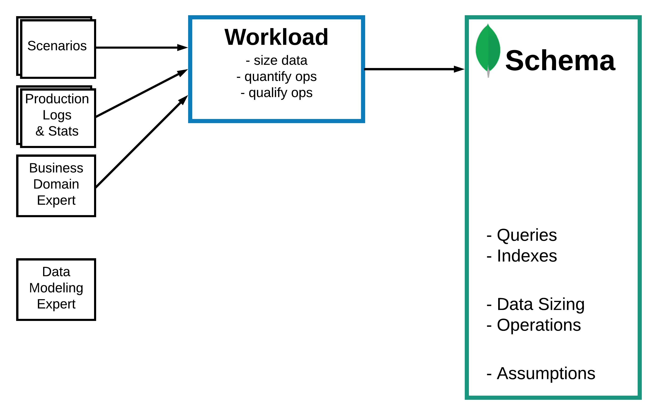
Data Modelling Methodology
Describe the Workload

Slide 29
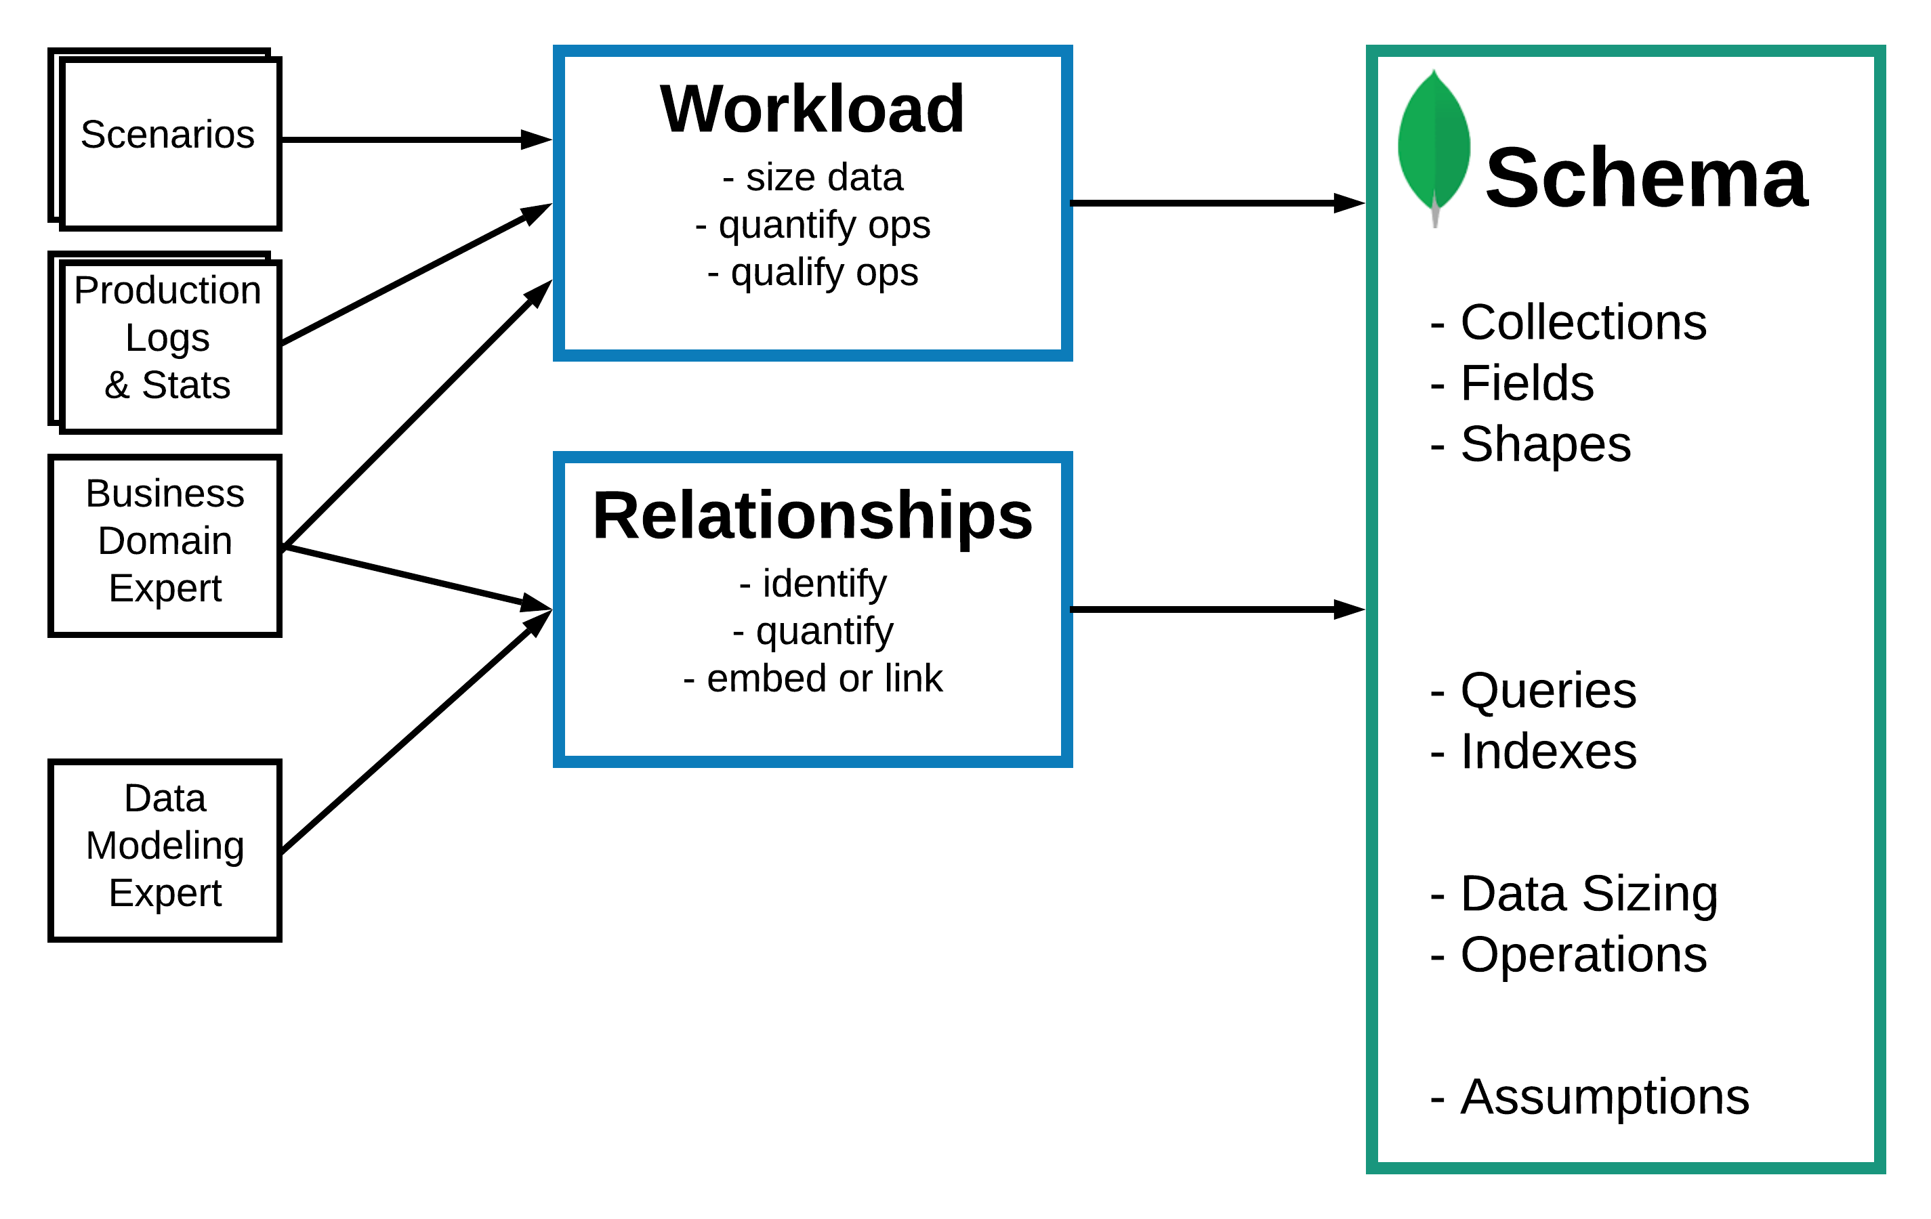
Data Modelling Methodology
Describe the Workload
Identify and Model the Relationships

Slide 30
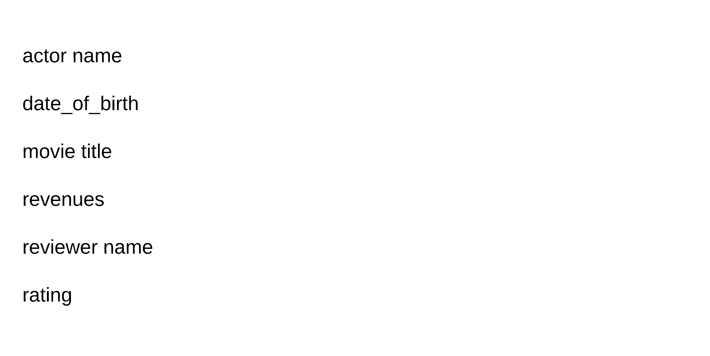
Notes:
Units of information for the domain to model
Example from a movie Website

Slide 31
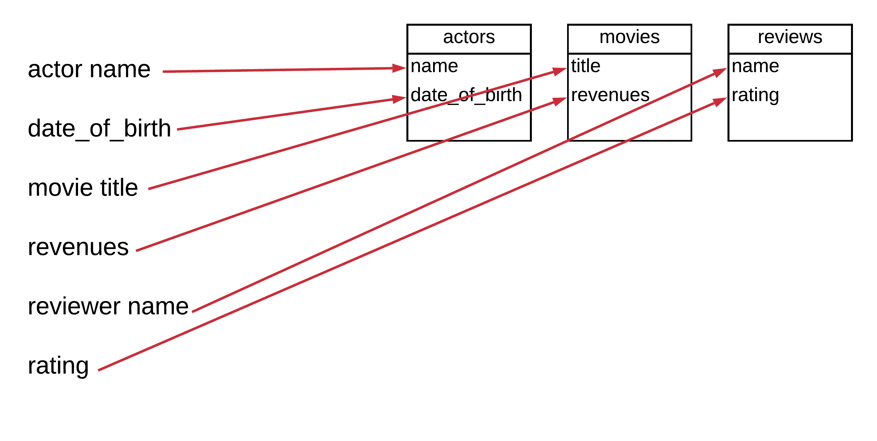

Slide 32
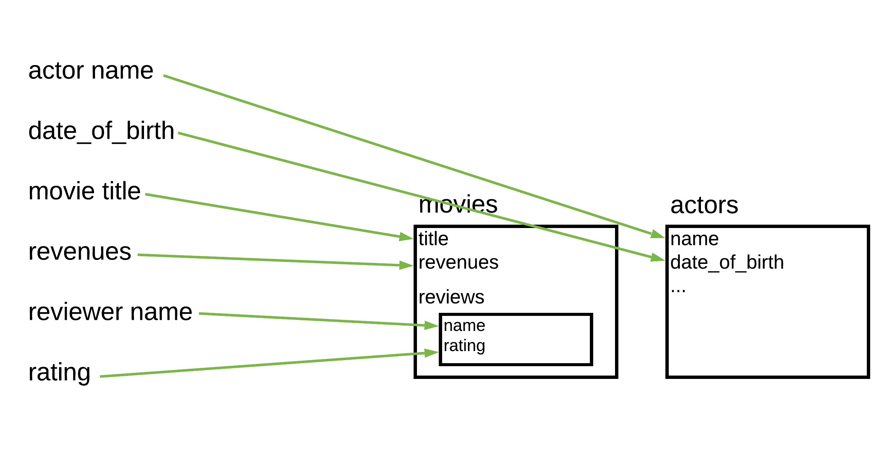
Notes:
- When you think in documents, you may assign the reviews info directly in the movies

Slide 33
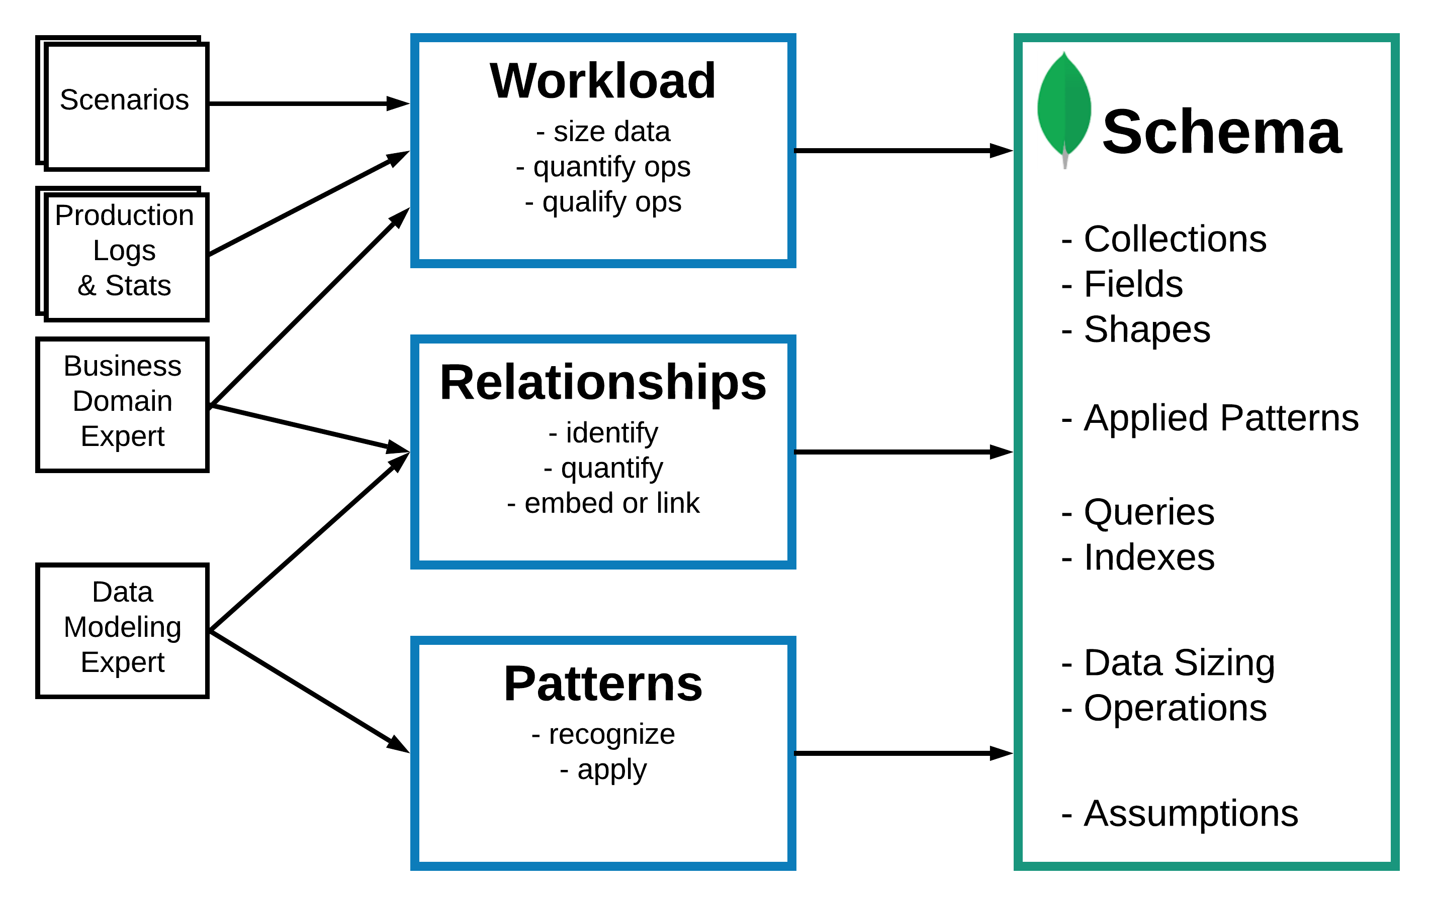
Data Modelling Methodology
Describe the Workload
Identify and Model the Relationships
Apply Patterns
Notes:
A lot of patterns are about performance. Only apply them if they are needed
More on why we have patterns and we will come back to them

Slide 34
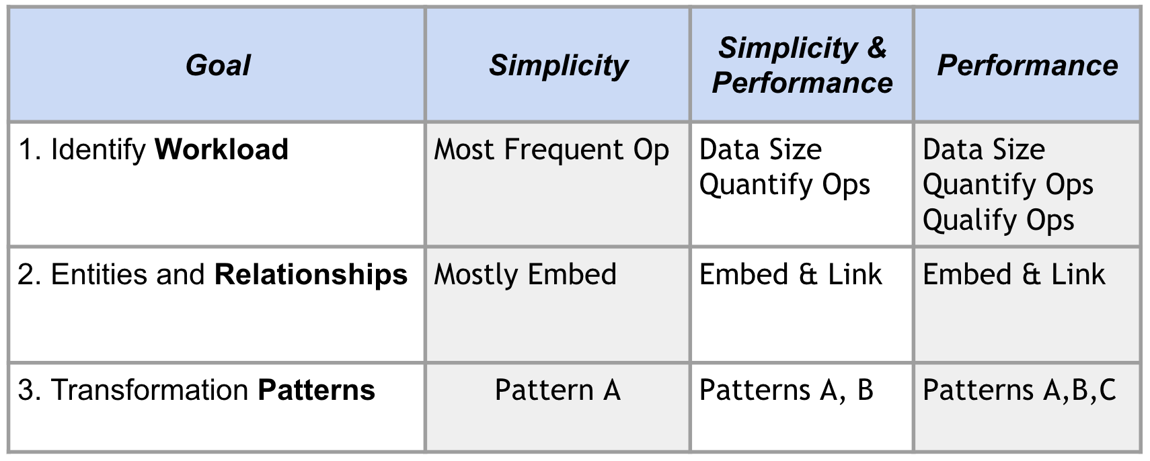
Flexible Methodology
See details on common patterns in the next section of this deck
Notes:
The methodology can be kept simple

Slide 35
Part 3: Document Modeling Design Patterns

Slide 36



Patterns by Category
Representation
Attribute ✔️
Schema Versioning ✔️
Document Versioning
Tree
Polymorphism
Pre-Allocation
Frequency of Access
Subset ✔️
Approximation ✔️
Extended Reference
Grouping
Computed ✔️
Bucket
Outlier
Notes:
Categories, top 5 most frequent patterns
We will use patterns, like the Gang of Four.
Most patterns can be grouped in 3 categories.
We will cover those patterns identified with check marks in this presentation.
Also, I will cover the patterns in order of importance, or so.
For the other ones, I will refer you to the slides of this presentation and subsequent content we will have on the subject.

Slide 37
Issue #1: Big Documents, Many Fields and Many Indexes
{
title: "Dunkirk",
...
release_USA: "2017/07/23",
release_Mexico: "2017/08/01",
release_France: "2017/08/01",
release_Festival_San_Jose: "2017/07/22"
}
Would need the following indexes: { release_USA: 1 }
{ release_Mexico: 1 }
{ release_France: 1 }
...
{ release_Festival_San_Jose: 1 } ...
Notes:
Documents are too big
How do I search on movies being released on a given date in the USA?
The same would apply to products you could see on E-commerce site.
For example, clothes may have a size that is expressed as S, M, L, while for some other products like a laptop, size would be something like 13", 15"

Slide 38
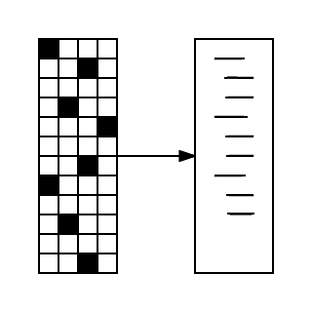
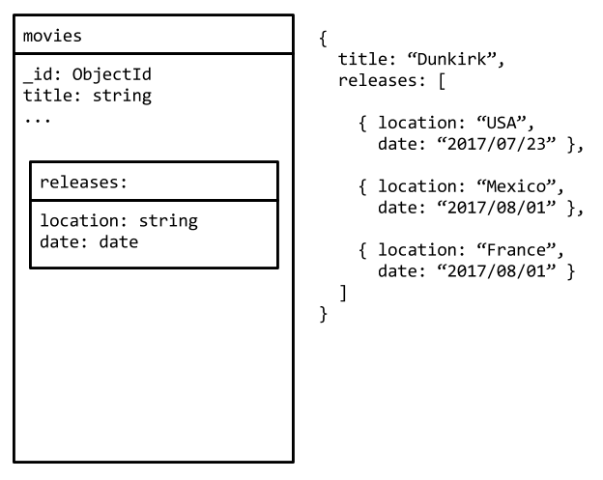
Pattern #1: Attribute
{
title: "Dunkirk",
...
release_USA: "2017/07/23",
release_Mexico: "2017/08/01",
release_France: "2017/08/01",
release_Festival_San_Jose: "2017/07/22"
}

Slide 39
Attribute Pattern
Problem:
Lots of similar fields
Common characteristic to search across those fields together
Fields present in only a small subset of documents
Use cases:
Product attributes like ‘color’, ‘size’, ‘dimensions’, ...
Release dates of a movie in different countries, festivals
Notes:
Inventory of things to insure
Polymorphic entities
Vehicles: submarine, car

Slide 40
Attribute Pattern - Solution
Solution:
Field pairs in an array
Benefits:
Allow for non deterministic list of attributes
Easy to index
{ "releases.location": 1, "releases.date": 1 }
Easy to extend with a qualifier, for example:
{ descriptor: "price", qualifier: "euros", value: Decimal(100.00) }
Notes:
"Adding a qualifier on the attribute" may be "currency"

Slide 41
Issue #2: Working Set Doesn’t Fit in RAM
Possible solutions:
Reduce the size of your working set
Add more RAM per machine
Start sharding or add more shards
Notes:
Definition of Working set
With everyone pounding on the WMDB site, it was observed that the working set does not fit in memory.
What can you do?
Looking at the design we see that we are putting all the actors and all reviews for a given movie in the main document
[TODO] Add a drawing showing what the working set is

Slide 42
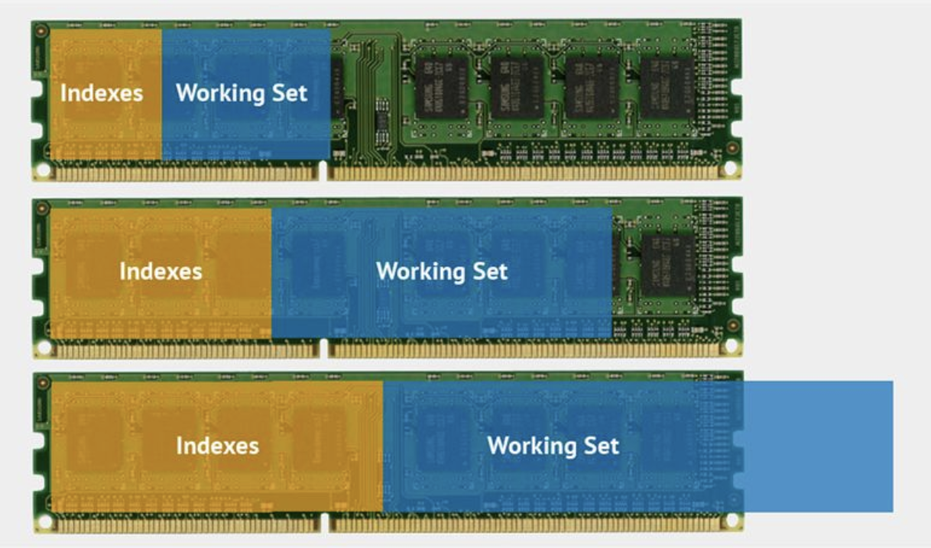
WORKING SET
Notes:
Definition of Working set
Working set represents the total body of data that the application uses in the course of normal operation. Often this is a subset of the total data size, but the specific size of the working set depends on actual moment-to-moment use of the database.
If you run a query that requires MongoDB to scan every document in a collection, the working set will expand to include every document. Depending on physical memory size, this may cause documents in the working set to “page out,” or to be removed from physical memory by the operating system. The next time MongoDB needs to access these documents, MongoDB may incur a hard page fault.
For best performance, the majority of your active set should fit in RAM.

Slide 43
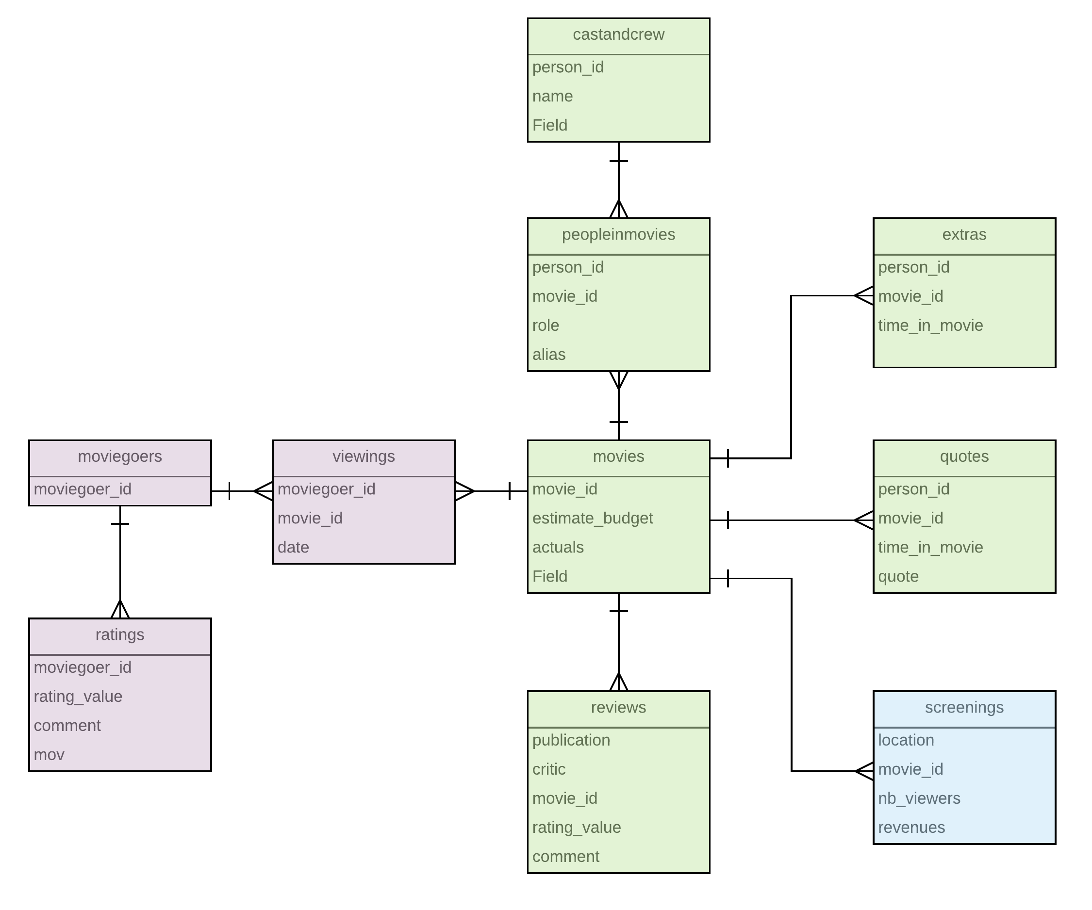
WMDB - World Movie Database
First iteration 3 collections:
movies
moviegoers
screenings
Notes:
Remember this collection in the middle?

Slide 44
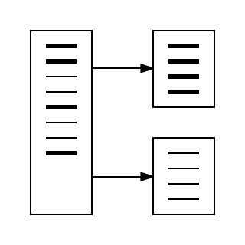
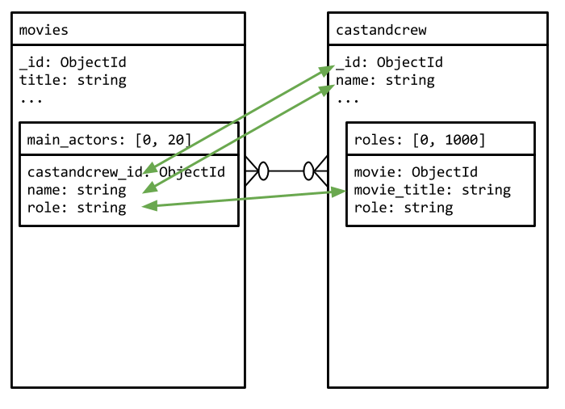
Pattern #2: Subset
In this example, we can:
Limit the list of actors and crew to 20
Limit the embedded reviews to the top 20
…
Notes:
The collection "castandcrew" contains all the actors, but also the producers, costume makers, stunts, etc.
For this pattern to be worth it, it has to have a fair amount of information left aside.

Slide 45
Subset Pattern - Solution
Solution:
Keep duplicates of a small subset of fields in the main collection
Benefits:
Allows for fast data retrieval and a reduced working set size
One query brings all the information needed for the "main page"

Slide 46

Issue #3: Lot of CPU Usage
CPU is on fire!
Notes:
What causes the CPU to heat up?

Slide 47
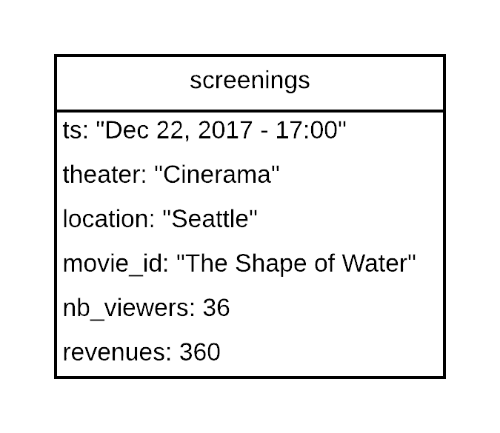


Issue #3: ...caused by repeated calculations
{
title: "The Shape of Water",
...
viewings: 5,000
viewers: 385,000
revenues: 5,074,800
}
Notes:
As you may guess, people pay attention to the popularity of the movies.
So, metrics like "revenues" and "viewers" are really important.
In the current design, those numbers are calculated every time the page of a movie is displayed.
Let’s calculate those numbers once in a while and stick the results on the page instead.

Slide 48
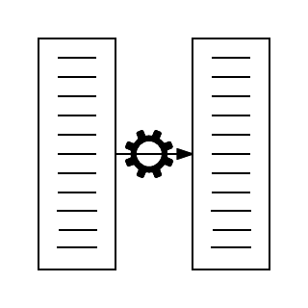
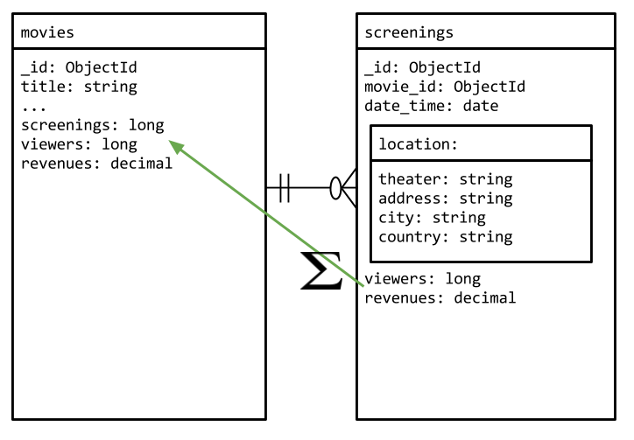
Pattern #3: Computed
For example:
Apply a sum, count, ...
rollup data by minute, hour, day
As long as you don’t mess with your source, you can recreate the rollups
Notes:
Also refer to "Rolled up" as CQRS - Command Query Responsibility Segregation

Slide 49
Computed Pattern
Problem:
There is data that needs to be computed
The same calculations would happen over and over
Reads outnumber writes:
example: 1K writes per hour vs 1M read per hour
Use cases:
Have revenues per movie showing, want to display sums
Time series data, Event Sourcing

Slide 50
Computed Pattern - Solution
Solution:
Apply a computation or operation on data and store the result
Benefits:
Avoid re-computing the same thing over and over
Replaces a view

Slide 51
Issue #4: Lots of Writes
Notes:
Another thing that was observed with the current design is that trying to keep track of all page views of the site resulted in very poor performance. That was seen for both MMAPv1 and WT.
In MMAPv1, you get a lot of threads looking for the write lock.
While with WT, you get a lot of write conflicts that need to be retried.
One solution is to record "good enough" numbers. Is it important that the count is 525 million or 525,00,234. What is the tolerance level here? Let’s assume 1000.
In this case, we will let the application update the page views by 1000, however only 1/1000th of the time. Statistically, we should get a result very close to the exact count, however doing only 1/1000th of the writes.
If you make the parallel to a movie, we never see a movie as a continuous image, the movie is made by displaying 24 static images per second, however this is enough to our eyes to not see the discontinuties.
How do you do that? Let’s have the application run a (X mod 1000) operation, where X is a random number. If the result is 0, let’s update the counter by 1000.

Slide 52
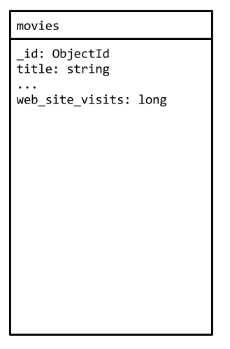

Issue #4: … For Non Critical Data
Notes:
Another thing that was observed with the current design is that trying to keep track of all page views of the site resulted in very poor performance. That was seen for both MMAPv1 and WT.
In MMAPv1, you get a lot of threads looking for the write lock.
While with WT, you get a lot of write conflicts that need to be retried.
One solution is to record "good enough" numbers. Well no one cares that the count is 100 millions or 100 millions and few. What is the tolerance level here? Let’s assume 1000.
In this case, we will let the application update the page views by 1000, however only 1/1000th of the time. Statistically, we should get a result very close to the exact count, however doing only 1/1000th of the writes.
If you make the parallel to a movie, we never see a movie as a continuous image, the movie is made by displaying 24 static images per second, however this is enough to our eyes to not see the discontinuities.
How do you do that? Let’s have the application run a (X mod 1000) operation, where X is a random number. If the result is 0, let’s update the counter by 1000.

Slide 53
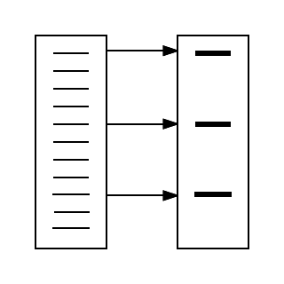
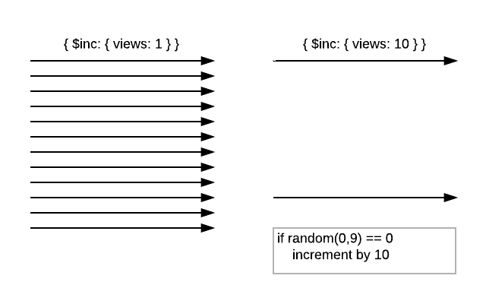
Pattern #4: Approximation
Only increment once in X iterations
Increment by X
Notes:
You can have a counter. Once you reach the count, you do the write.
Or you can use a random generator and when you get a specific value, you do the write.
As you might guess, this simple pattern is also applicable to Relational databases.
… it is just that NoSQL people have more tricks to handle performance bottlenecks.

Slide 55
Approximation Pattern
Problem:
Data is difficult to calculate correctly
May be too expensive to update the document every time to keep an exact count
Exactness of count may not be of high concern
Use cases:
Population of a country
Web site visits

Slide 56
Approximation Pattern – Solution
Solution:
Fewer stronger writes
Benefits:
Less writes, reducing contention on some documents

Slide 57
Issue #5: Need to Change the List of Fields in the Documents
Keeping track of the schema version of a document
Notes:
Let's face it configuration management and database usually don't work well together.
Database tend to keep the "latest" state of your data, while "CM" systems remember everything. Those of us who checked in stupid mistakes in Git, ClearCase, etc know CM systems have a very long memory.
For this pattern, we are keeping track of the shape of the document. We are not addressing keeping track of the different contents of the document itself. This other case is solved by the Document Versioning pattern.

Slide 58
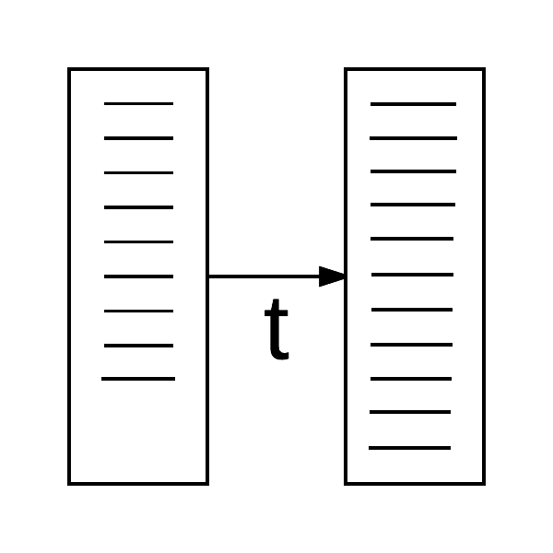
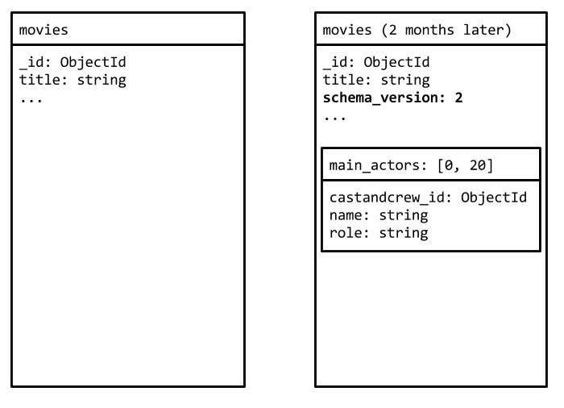
Pattern #5: Schema Versioning
Add a field to track the schema version number, per document
Does not have to exist for version 1
Notes:
Instead of using a "version" field, we could discover the version number based on fields

Slide 59
Schema Versioning Pattern
Problem:
Updating the schema of a database is:
Not atomic
Long operation
May not want to update all documents, only do it on updates
Use cases:
Practically any database that will go to production
Notes:
- Few million references would not even fit into an embedded array. And if it did, you would not want to construct a query by passing a million values to the $in operator.

Slide 60
Schema Versioning Pattern – Solution
Solution:
Have a field keeping track of the schema version
Benefits:
Don't need to update all the documents at once
May not have to update documents until their next modification

Slide 61
What our Patterns did for us
Problem | Pattern
Messy and Large Documents | Attribute
Too much RAM | Subset
Too much CPU | Computed
Too many disk accesses | Approximation
Incur downtime to upgrade schema | Schema Versioning

Slide 62
Other Patterns
Bucket
Grouping documents together, to have less documents
Document Versioning
Tracking of content changes in a document
Outlier
Avoid few documents driving the design and impact performance for all
External Reference
Tree(s)
Polymorphism
Pre-allocation
Notes:
The bucket pattern lets you group X sub-documents into one document. When the bucket is full, you create another one.
Pre-allocation will be the case where you pre-create an array of cells to have the reads and writes easily access the elements. This is a very important pattern if you are using MMAPv1, as continuously growing an array can have a negative effect. With Wired Tiger it is not as crucial, however may make the code in the application simpler.
As for Trees, they are commonly represented by either having one node per document, where you can list the parent, the children, the ancestors, or a combination of those

Slide 63
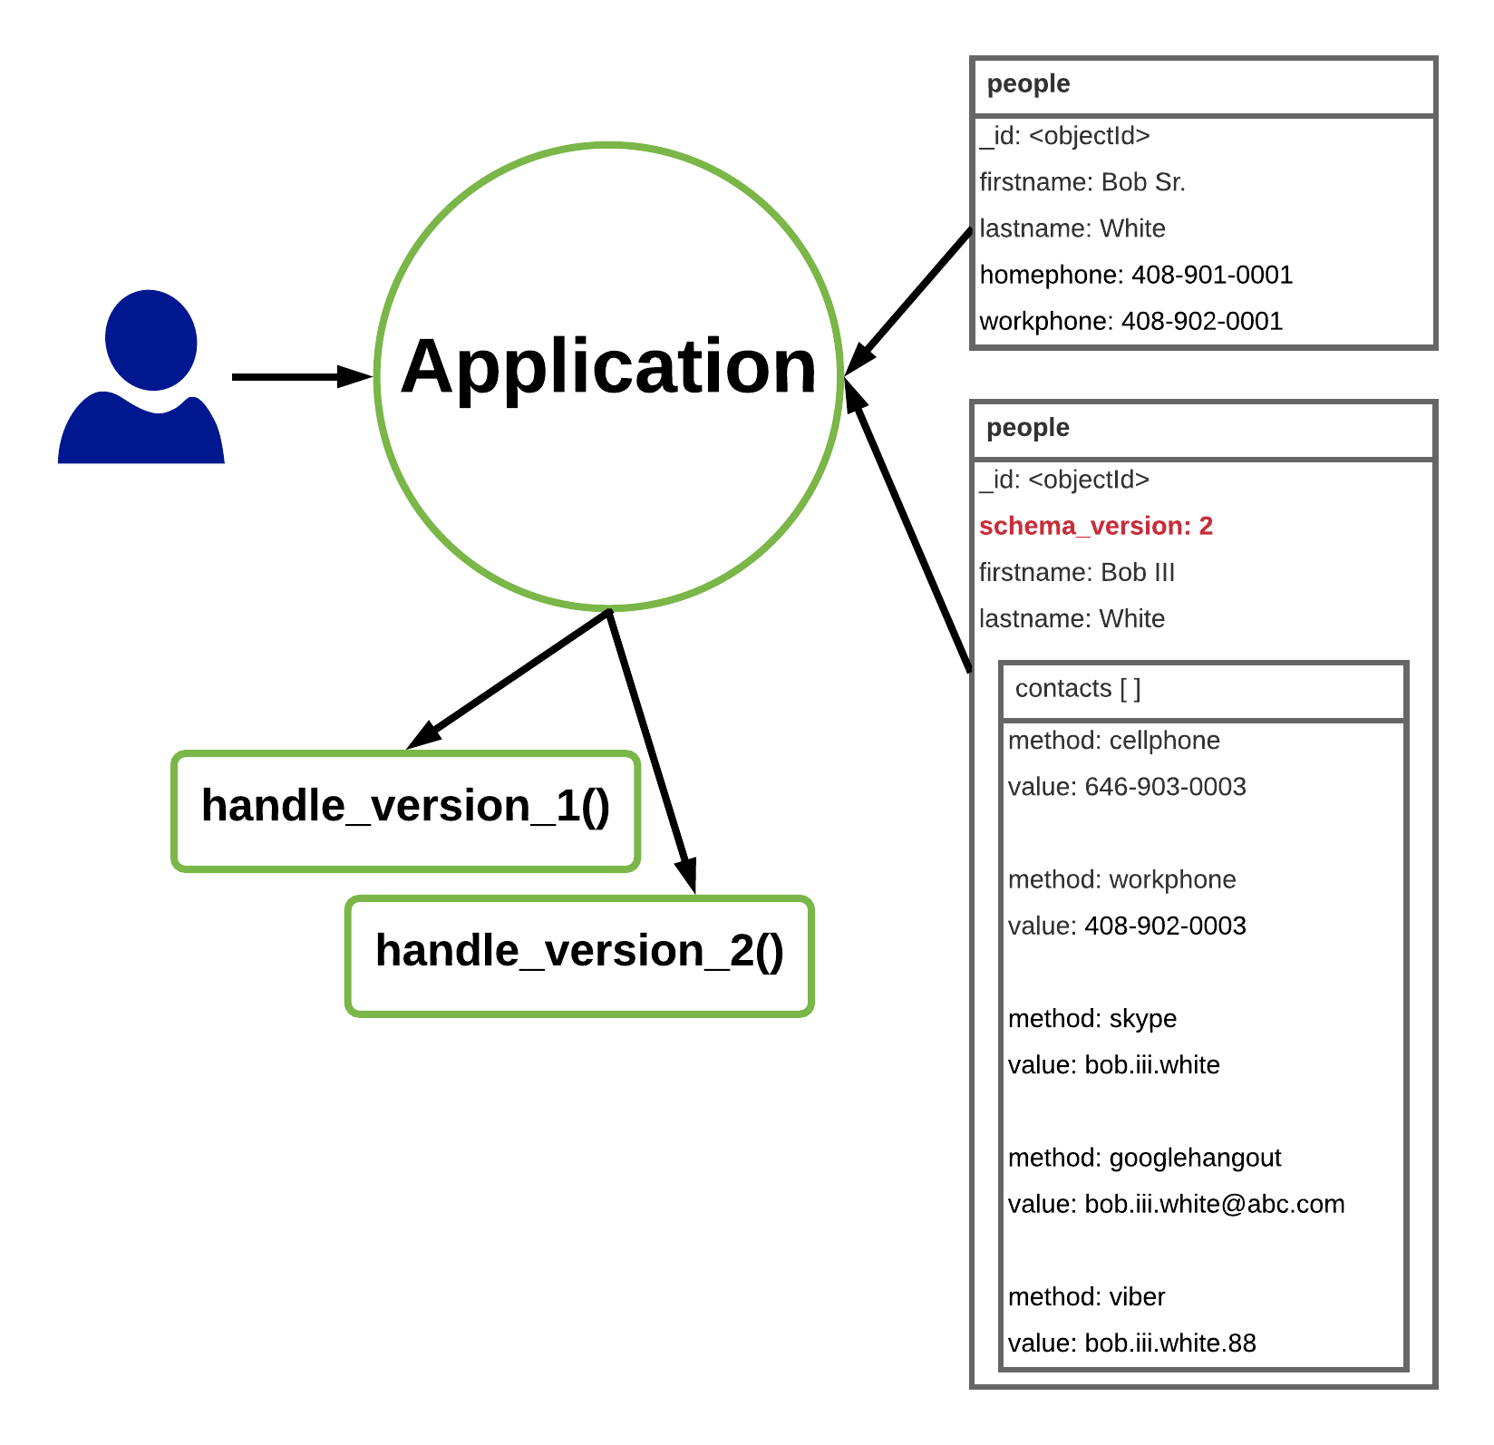
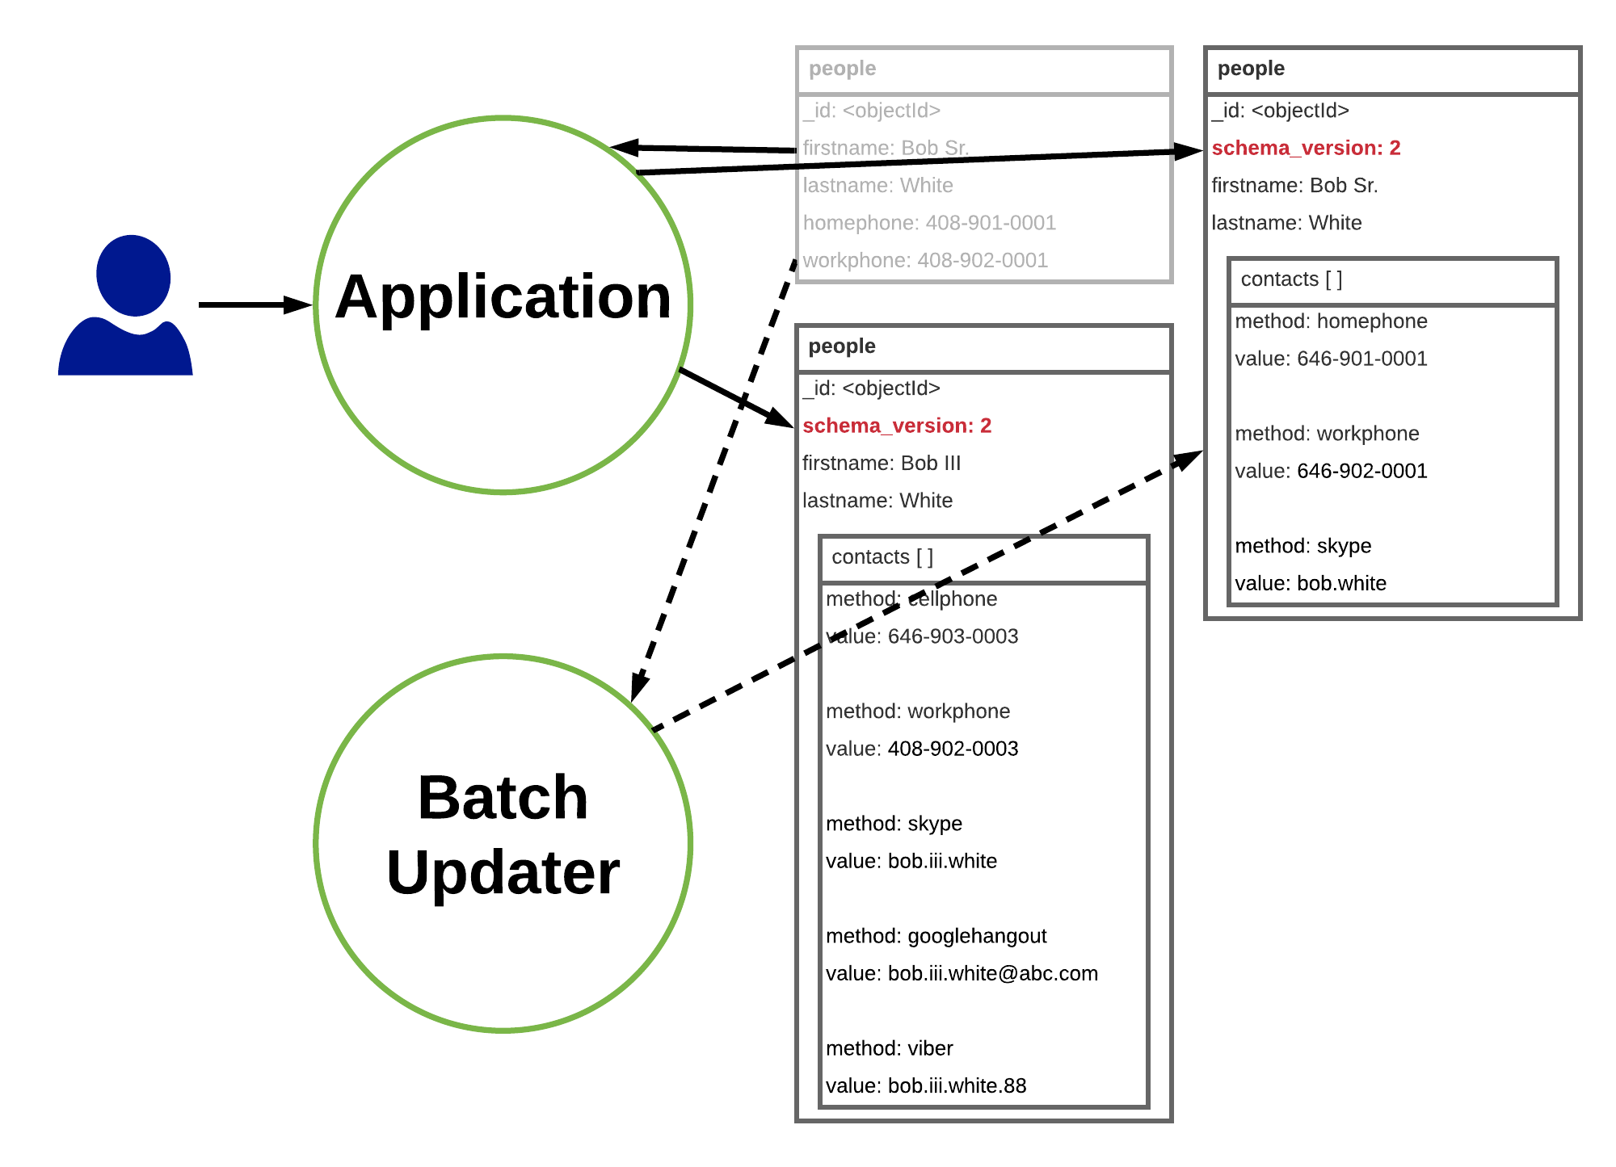
Schema Versioning

Slide 64
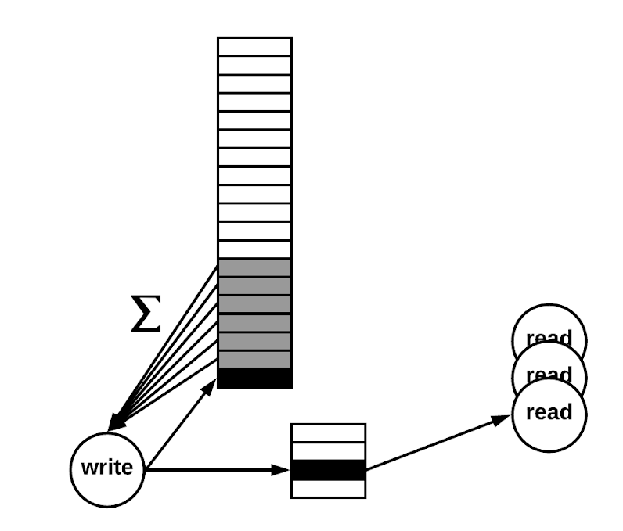
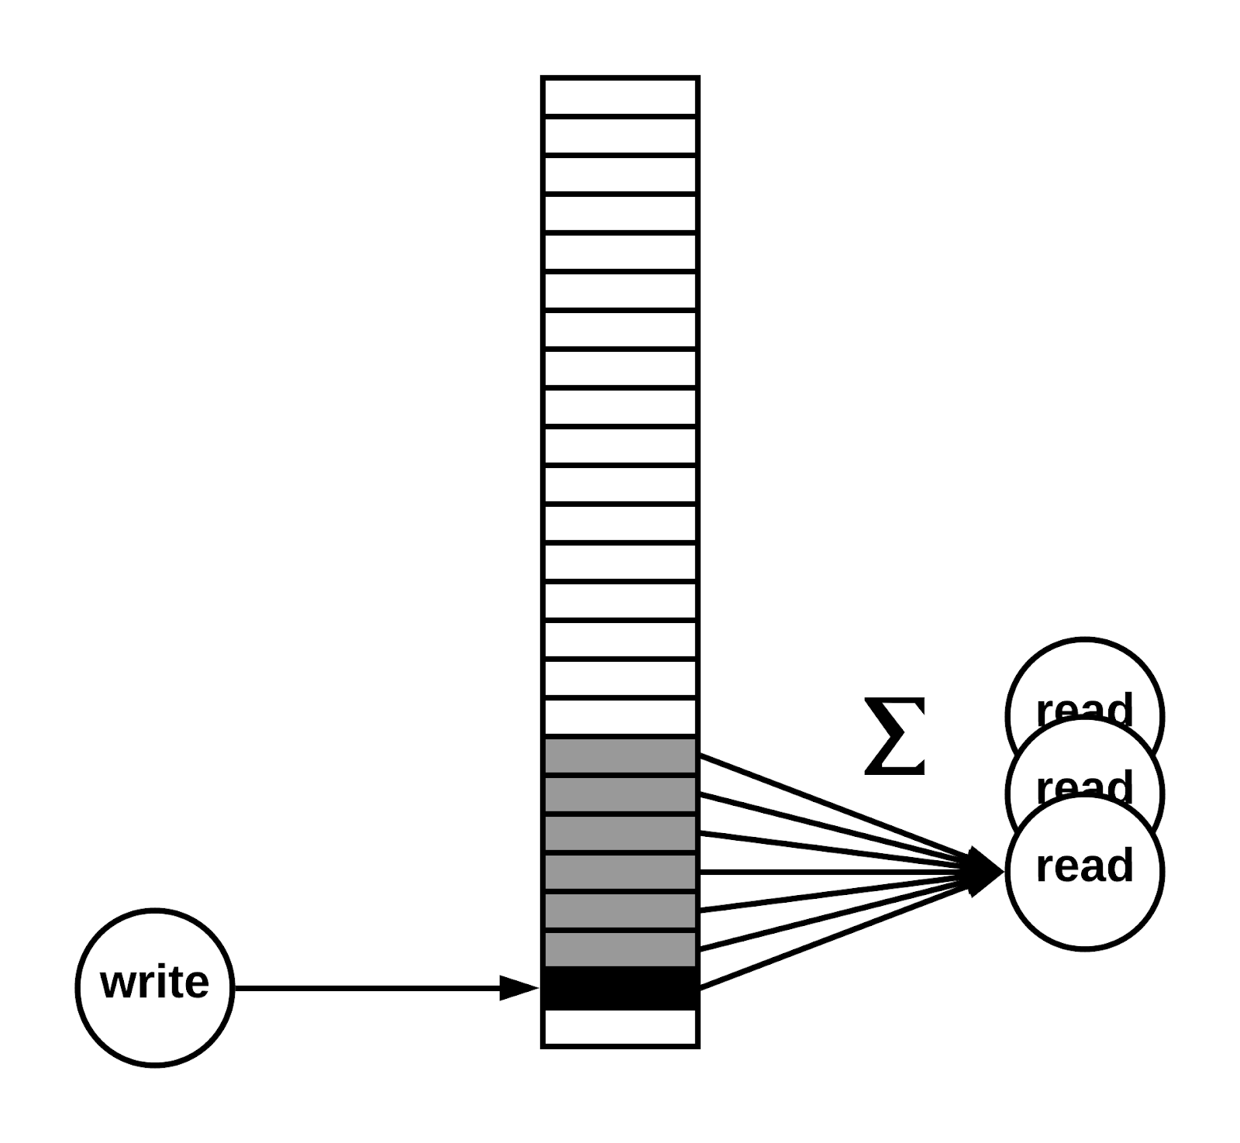
Computed Pattern

Slide 65
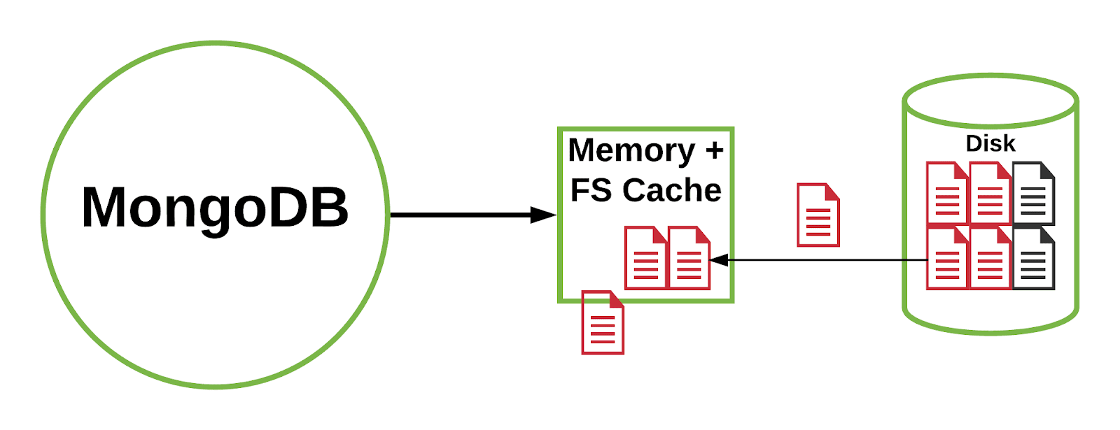
Subset Pattern

Slide 66
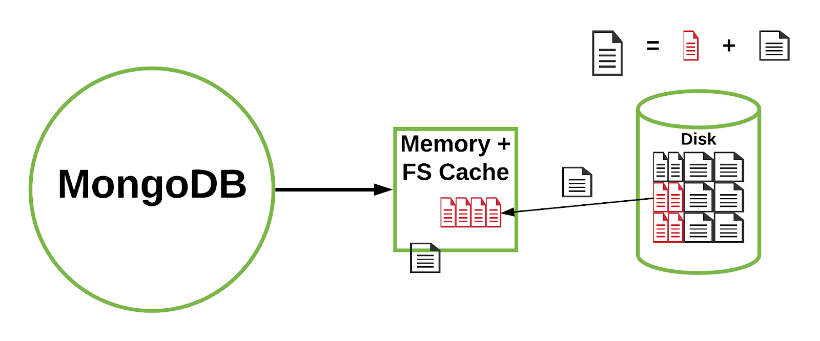
Subset Pattern

Slide 67
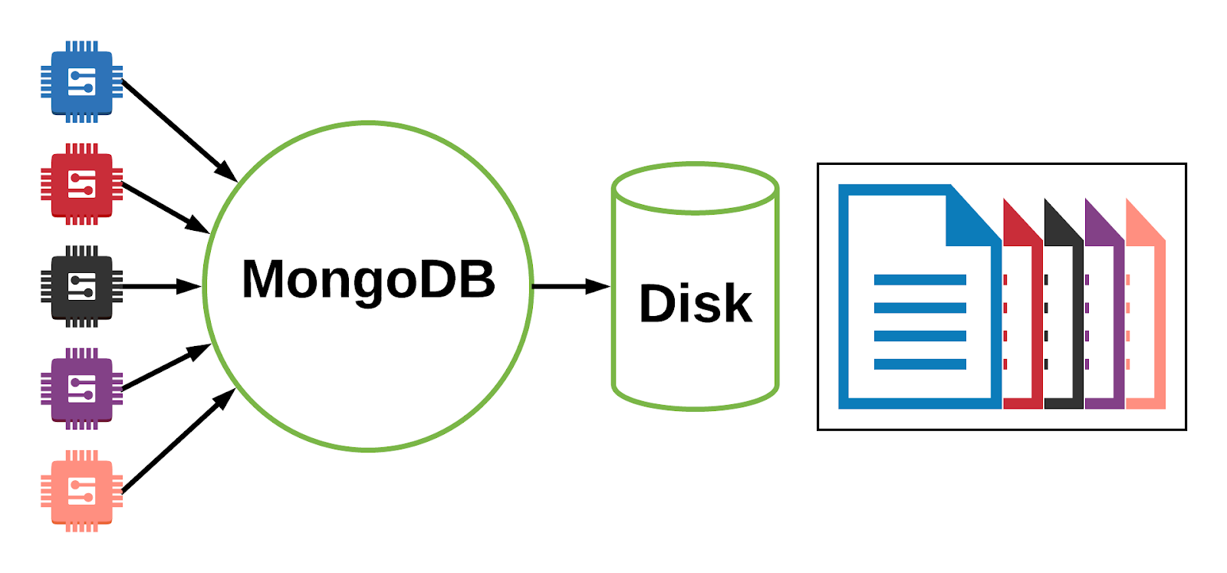
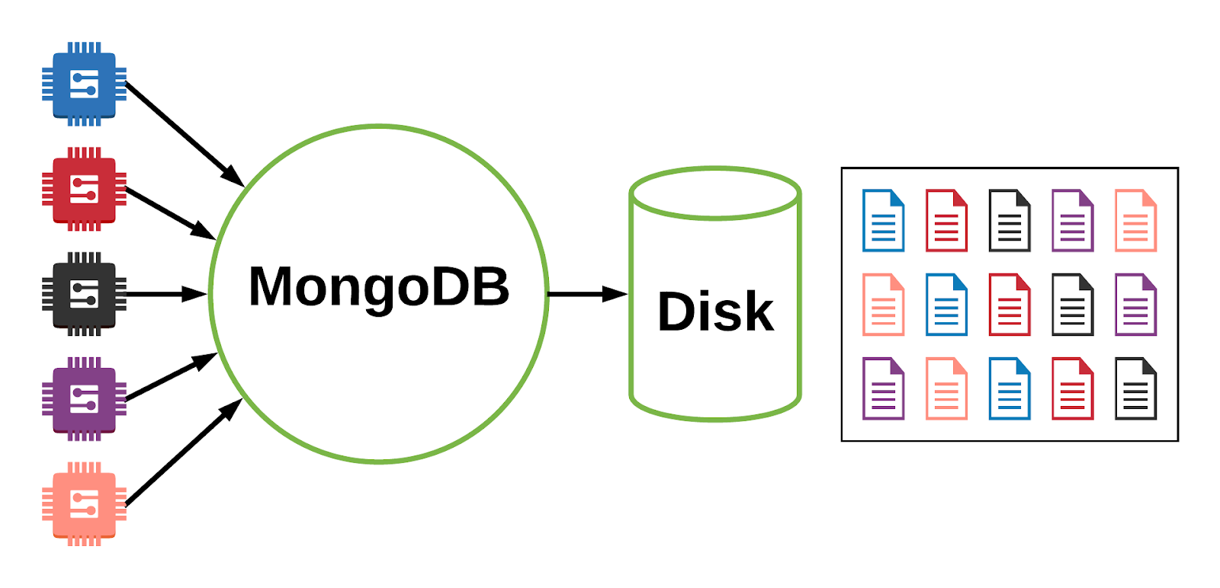
Bucket Pattern

Slide 68
Bucket Pattern
Bucket per Day
Bucket per Hour
{ "device_id": 000123456, "type": "2A", "date": ISODate("2018-03-02"), "temp": [ [ 20.0, 20.1, 20.2, ... ], [ 22.1, 22.1, 22.0, ... ], ... ] }
{ "device_id": 000123456, "type": "2A", "date": ISODate("2018-03-03"), "temp": [ [ 20.1, 20.2, 20.3, ... ], [ 22.4, 22.4, 22.3, ... ], ... ] }
{ "device_id": 000123456, "type": "2A", "date": ISODate("2018-03-02T13"), "temp": { 1: 20.0, 2: 20.1, 3: 20.2, ... } }
{ "device_id": 000123456, "type": "2A", "date": ISODate("2018-03-02T14"), "temp": { 1: 22.1, 2: 22.1, 3: 22.0, ... } }

Slide 69
Take Aways
Simple grouping from tables to collections is not optimal
Learn a common vocabulary for designing schemas with MongoDB
Use patterns as "plug-and-play" to improve performance
Notes:
10 years of experience, building schema with the document model
You may not know about all the solutions, however we collected those over our 10 years of working with customers.
If you follow this advice, good things will happen.
Armed with those patterns, you may feel like a SuperHero, more powerful

Slide 70


References for complete Solutions
A full design example for a given problem:
E-commerce site
Contents Management System
Social Networking
Single view
…
Notes:
My goal was to introduce you to patterns, however if you want more complete solutions to common problems, there are few good books out there. Let me point you to those 2:
The Little Mongo DB Schema Design Book Paperback, by Christian Kvalheim
MongoDB Applied Design Patterns, by Rick Copeland

Slide 71
Part 4: Time-Series Data Modelling

Slide 72
Time Series
A time series is a sequence of data points, measured typically at successive points in time spaced at uniform time intervals (Wikipedia)
e.g. IoT sensor data, system monitoring data, financial tick data
time
0
2
4
6
8
10
12

Slide 73
Time Series Schema Design Goal
Store Event Data
Support Analytical Queries
Find best compromise of:
Memory utilization (especially for indexes)
Write performance
Amount of storage
Read/Analytical Query Performance
Accomplish with realistic amount of hardware

Slide 74
Designing For Reading, Writing, …
Document per event
Document per minute (average)
Document per minute (second)
Document per hour

Slide 75
Document Per Event
{
segId: “I80_mile23”,
speed: 63,
ts: ISODate("2013-10-16T22:07:38.000-0500")
}
Relational-centric approach
Insert-driven workload

Slide 76
Document Per Minute (Average)
{
segId: “I80_mile23”,
speed_num: 18,
speed_sum: 1134,
ts: ISODate("2013-10-16T22:07:00.000-0500")
}
Pre-aggregate to compute average per minute more easily
Update-driven workload
Resolution at the minute-level

Slide 77
Document Per Minute (By Second)
{
segId: “I80_mile23”,
speed: { 0: 63, 1: 58, …, 58: 66, 59: 64 }
ts: ISODate("2013-10-16T22:07:00.000-0500")
}
Store per-second data at the minute level
Update-driven workload

Slide 78
Document Per Hour (By Second)
{
segId: “I80_mile23”,
speed: { 0: 63, 1: 58, …, 3598: 45, 3599: 55 }
ts: ISODate("2013-10-16T22:00:00.000-0500")
}
Store per-second data at the hourly level
Update-driven workload
Updating last second requires 3599 steps

Slide 79
Document Per Hour (By Second)
{
segId: “I80_mile23”,
speed: {
0: {0: 47, …, 59: 45},
….
59: {0: 65, …, 59: 66}
ts: ISODate("2013-10-16T22:00:00.000-0500")
}
Store per-second data at the hourly level with nesting
Update-driven workload
Updating last second requires 59+59 steps (“intra-document hierarchy” pattern)

Slide 80
Characterizing Write Differences
Example: data generated every second
For 1 minute:
Transition from insert driven to update driven
Individual writes are smaller
Performance and concurrency benefits
Document Per Event
60 writes
Document Per Minute
1 write, 59 updates

Slide 81
Characterizing Read Differences
Example: data generated every second
Reading data for a single hour requires:
Read performance is greatly improved
Optimal with tuned block sizes and read ahead
Fewer disk seeks
Document Per Event
3600 reads
Document Per Minute
60 reads

Slide 82
Characterizing Memory Differences
_id index for 1 billion events:
_id index plus segId and ts index:
Memory requirements significantly reduced
Fewer shards
Lower capacity servers (far less RAM especially)
Document Per Event
~32 GB
Document Per Minute
~.5 GB
Document Per Event
~100 GB
Document Per Minute
~2 GB

Slide 83

CHOOSING A SHARD KEY FOR TIME SERIES DATA
Cardinality - LARGE
Write distribution - EVEN
Query isolation - ISOLATED
Notes:
One last topic on sharding, though: choosing the shard key.
This is important to consider at the beginning of your design because unlike the overall data model which is flexible, the shard key cannot be changed once data begins to flow into the database.
Three factors influence the construction of a good shard key: cardinality, write distribution, and query isolation.

Slide 84
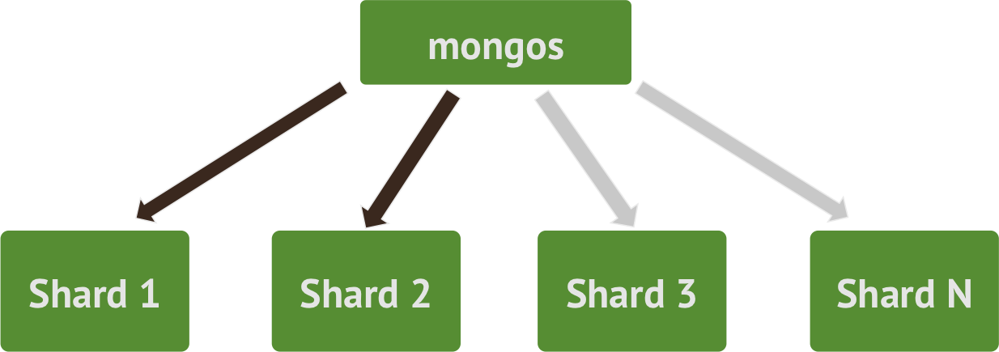
Shard Keys
A good shard key has:
sufficient cardinality
distributed writes
targeted reads (query isolation)
Shard key should be in every query if possible
scatter gather otherwise
Choosing a good shard key is important!
affects performance and scalability
changing it later is expensive
…

Slide 85
Hashed Shard Key
Pros:
Evenly distributed writes
Cons:
Range-based queries turn into scatter gather
Random data (and index) updates can be I/O intensive, although this is unlikely for immutable time series data
Likely not a good candidate for time series data due to range queries
…

Slide 86
Bad Shard Key: insufficient cardinality
Examples: asset_id hex or station id
Induces unsplittable "jumbo chunks"
mongos
Shard 1
Shard 2
Shard 3
…
Shard N

Slide 87
Bad Shard Key: monotonically increasing
Examples: timestamp or _id
Causes "hot spots" on inserts
mongos
{ ISODate("2016-06-29T23:59:59Z"), +∞}
Shard 1
Shard 2
Shard 3
…
Shard N

Slide 88
Choosing a shard key for our time series data
Consider compound shard key of {arbitrary value, incrementing value}
Example: { asset_id:1, timestamp:1 }
Best of both worlds: distributed writes (local hot spots), targeted reads
mongos
{ "AB20C0", ISODate("2016-06-29T23:59:59Z"), +∞ }
{ "807EEE", ISODate("2016-06-28T22:14:59Z"), +∞ }
Shard 1
Shard 2
Shard 3
…
Shard N
{ "0D07F8", ISODate("2016-06-28T23:27:52Z"), +∞ }
{ "A19CAC", ISODate("2016-06-28T22:45:16Z"), +∞ }

Slide 89

 | Cardinality | Write Distribution | Query Isolation | Index Locality
_id | Doc level | One shard | Scatter/gather | Good
hash(_id) | Hash level | All Shards | Scatter/gather | Poor
asset_id | Many docs | All Shards | Targeted | Good
asset_id, ts | Doc level | All Shards | Targeted | Good
CHOOSING A SHARD KEY
Cardinality
Write distribution
Query isolation
Reliability
Index locality
Notes:
Let’s explore some candidate shard keys in the context of the 3 important factors plus 2 others.
_id: Primary ID:
Cardinality = # of rows, so that’s nice and high.
Write distribution: potentially too closely clustered on one shard, making it “hot”.
Query isolation: Turns into scatter gather, which impacts linear scaling of cluster.
Hash(_id):
Cardinality = # of rows assuming the hash function is good, so that’s nice and high.
Write distribution: Probably nicely distributes writes across the cluster, but at the expense of….
Query isolation: Almost guarantees no isolation of query
Asset_id:
Cardinality = Many docs but not terrible
Write distribution: Well distributed
Query isolation: Well isolated; we now can support excellent concurrent queryability at scale
Reliability: Losing an entire shard (INCLUDING REPLICAS!) means a well defined set of assets become unavailable instead of at least a few of the inputs (based on _id or hash(_id)) from ALL the assets becoming unavailable.
Asset_id + timestamp:

